Slide 1
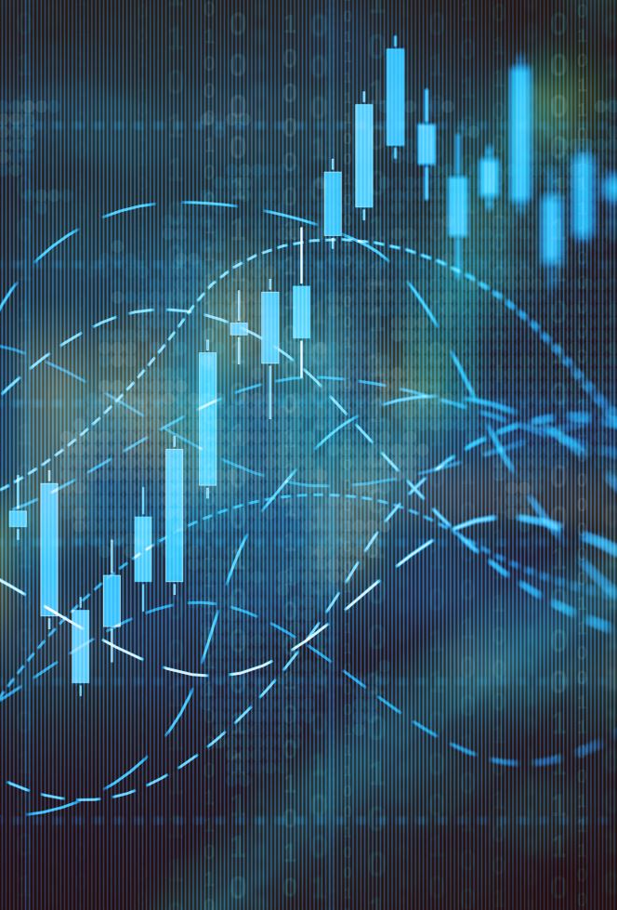
Algorithmic financial trading with deep convolutional neural networks: Time series to image conversion approach
Omer Berat Sezer, Ahmet Murat Ozbayoglu
TOBB University of Economics and Technology, Ankara 06560, Turkey

Slide 2
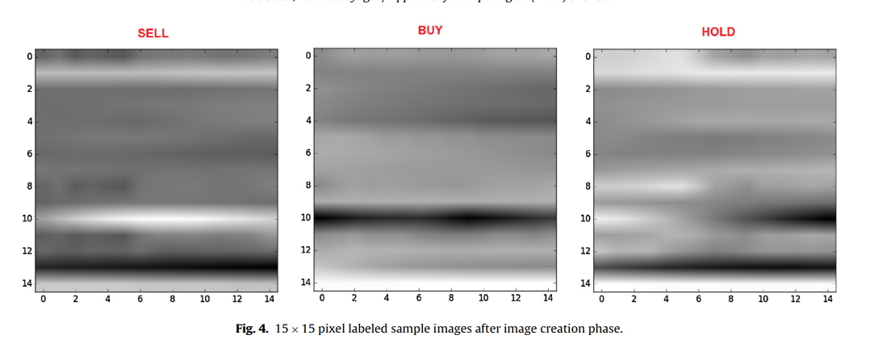
Introduction
Goal: To generate use a convolutional neural network to make predict the optimal trading strategy (sell, buy or hold)
Use time series data as rows in a ‘feature’ image

Slide 3
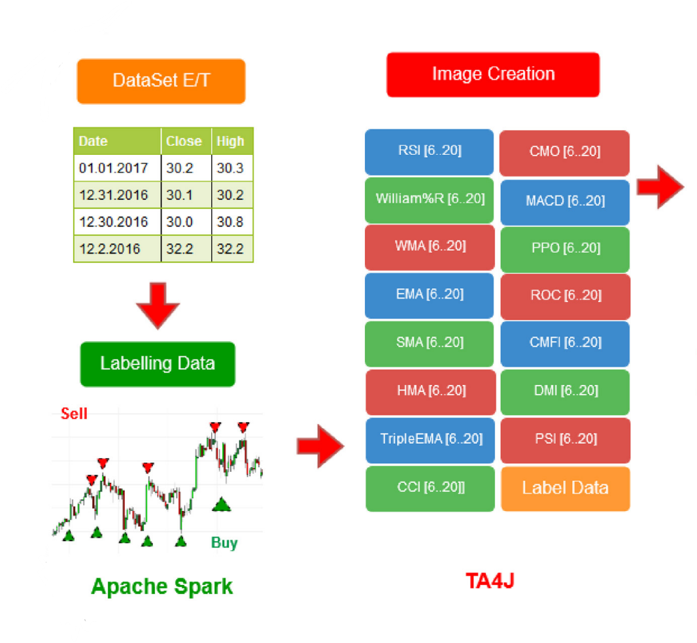
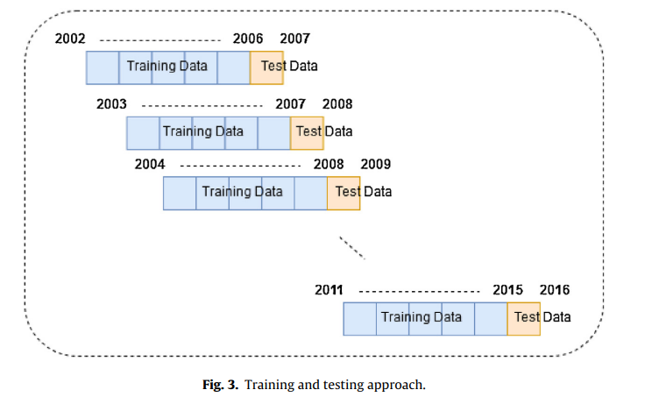
Data Set
ETFs from 1/1/2002 to 1/1/2017
Sliding window ‘training/testing approach’
‘A triple barrier’ like approach to labelling, but fixed width
Batched from before and after the 2008-2009 financial crisis. (2500 images for each stock from first period, and 1250 after)
# of Images Up-sampled to balanced (they didn’t mention this in paper – I found in code)

Slide 4
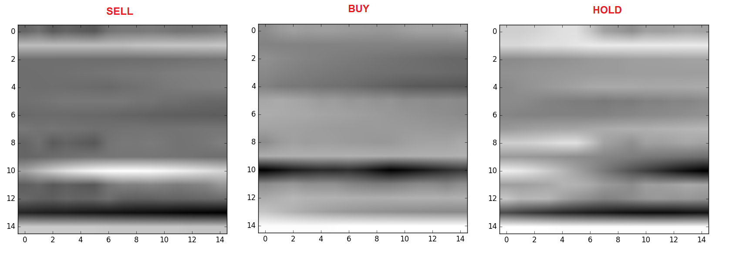
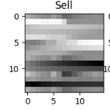
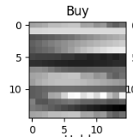
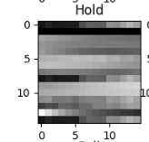
Image Creation
15 Technical Indicators
Clustered Indicator groups (oscillator or trend) and similar behaving indicators together or in proximity.
Stacked vertically to create a 15x15 image

Slide 5
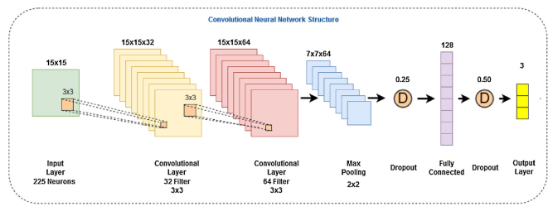
The Network
Two Convolutional Layers
32: 3x3 & 64: 3x3
Max Pooling
Fully Connected 128
ReLu/Softmax

Slide 6
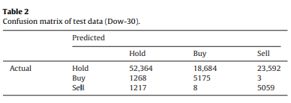
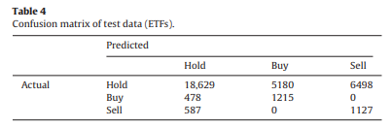
Performance (Computational)
Buy & Sell Seldom Confused
Many false positive entry/exit points
ETFs did better than Dow30, because ETF are less likely to the effected by political decisions, and economic crises – which creates a more stable environment for the model to operate.

Slide 7
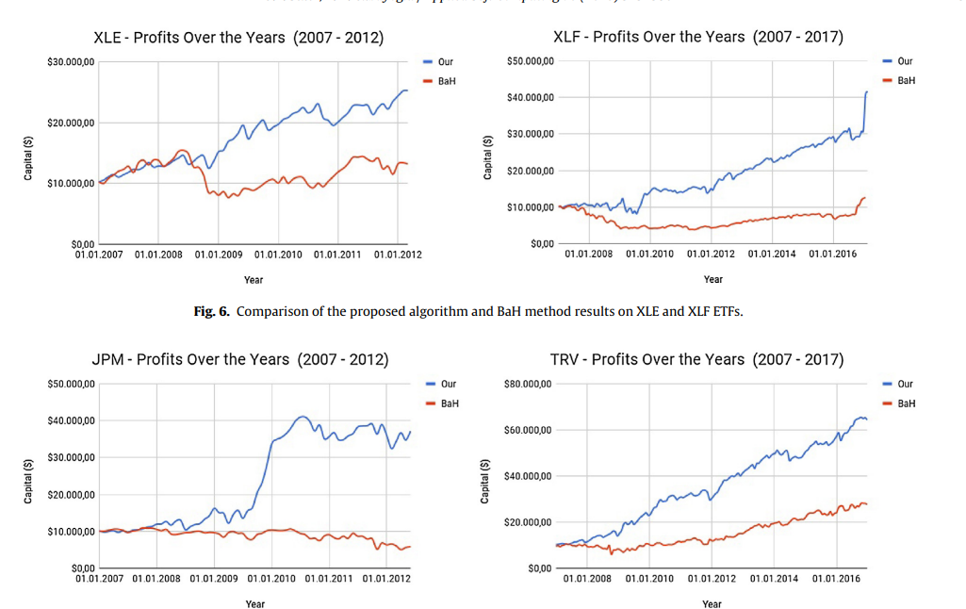
Performance (Financial)
Does better during the finical crisis than most other approaches
Does better more consistently as well

Slide 8

Future Work
Further experimentation with the order of the technical indicators in the image
Implement cross validation
Optimization of CNN parameters

Slide 9

Diving Deep: Examining the Code
Why did they drop the first 15 rows?
How come the images in the paper of blurry – it should be 15x15 – that looks much higher resolution? – the CNN code shows its on 15x15 image
They don’t mention in the paper rebalancing the dataset – but I found it in the code – done via up-sampling

